Slide 1
Developing an Interactive Gaming Software / Mobile Application on Intellectual Property (IP) Awareness for School Students
CSE7101- Capstone Project
Review-2
Batch Number:Com_09
Under the Supervision of,
Dr./Mr./Ms.Impa B H
Professor / Associate Professor / Assistant Professor
School of Computer Science and Engineering
Presidency University
Roll Number | Name
20221COM0215 | Darshan S
20221COM0150 | Uday
20211CEI0115 | Muhammad Shuaib
Roll Number | Student Name
20211CEI0115 20221COM0215 Darshan s | Muhammad Shuaib
Name of the Program: COM
Name of the HoD: D r Pallavi R
Name of the Program Project Coordinator:
Name of the School Project Coordinators: Dr. Sampath A K , Dr. Geetha A

Slide 2
Content
Abstract
Literature Survey
Objectives
Existing Methods & Feasibility Study
Proposed Method & Feasibility Study
Architecture Diagram
Modules
Hardware and Software Details
Github
Timeline of the Project
References

Slide 3
Abstract
This project aims to create an interactive gaming application to raise Intellectual Property (IP) awareness among school students. Using a quiz-based approach, students learn about copyrights, trademarks, patents, and trade secrets in an engaging and educational way. The application combines game-based learning, score tracking, and visual feedback to make IP concepts easy to understand and retain.

Slide 4
Literature Survey
Existing educational apps often focus on general subjects but rarely on IP awareness.
Gamified learning improves engagement and knowledge retention.
Sources referenced include online tutorials for HTML/JS, gamified learning research, and IP education articles.

Slide 5
Project Overview
This project aims to design and develop a game-based learning application that helps school students understand Intellectual Property Rights (IPR) such as copyright, trademarks, patents, trade secrets, and designs in a fun and interactive way. Instead of teaching IP laws in a textbook manner, the project uses gamification to make learning engaging and memorable.

Slide 6
🔹 Why This Project? (Need/Importance)
School students often lack awareness of intellectual property and may unknowingly copy or misuse content.
Gamification makes learning fun → Students are more motivated to play and learn.
Real-world relevance → Helps build creativity, originality, and respect for others’ work.
Promotes innovation & entrepreneurship mindset at a young age.

Slide 7
Existing Methods & Feasibility Study
Existing Methods:
Classroom lectures on IP.
PDFs or slides for IP concepts.
Online quizzes but mostly generic or not gamified.
Feasibility Study:
Web-based quiz is simple to implement, cross-platform, and does not require advanced hardware.
Can be scaled to mobile apps using frameworks like React Native or Flutter.

Slide 8
Proposed Method & Feasibility Study
Proposed Method:
Develop a web/mobile interactive quiz app on IP.
Include multiple-choice questions, instant feedback, and score tracking.
Feasibility Study:
Uses HTML, CSS, JavaScript for web version.
Mobile app feasible with React Native or Flutter.
No specialized hardware needed; runs on computers and mobile devices.

Slide 9
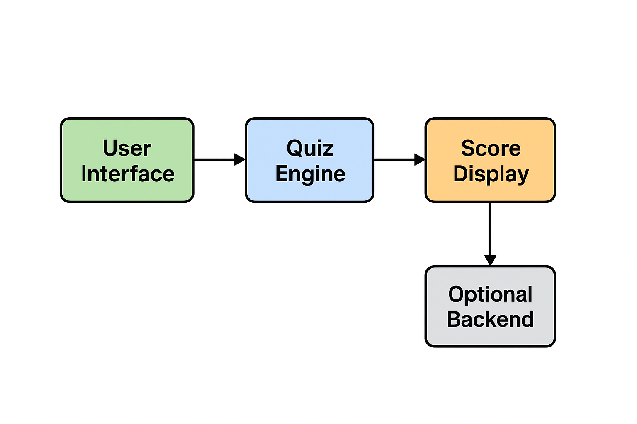
Architecture Diagram

Slide 10
Explaination
User Interface (UI):
The front-end where students interact with the quiz, answering questions and receiving feedback.
Quiz Engine:
The core logic that handles question sequencing, answer validation, and score calculation.
Score Display:
The module that shows the user's performance after completing the quiz.
Optional Backend (for saving scores):
A server-side component that can store user scores for tracking progress over time.

Slide 11
Modules
Question Module – Stores questions and options.
User Interaction Module – Displays questions and collects answers.
Score Module – Calculates and displays scores.
Progress Tracking Module – Optional: Save user scores for later reference.

Slide 12
Hardware and Software Details
1) Hardware:
PC / Laptop / Mobile device
Internet connection for online version
2) Software:
Code Editor: VS Code / Notepad++
Browser: Chrome / Firefox / Edge
Programming: HTML, CSS, JavaScript
Optional: React Native / Flutter for mobile app

Slide 13
🔹 Technology Stack
Frontend: Flutter / React Native (cross-platform mobile app).
Backend: Firebase / Node.js (for storing scores, user data).
Database: Firestore / MySQL.
Game Engine (optional): Unity (if it’s more game-oriented).
Graphics/Animation: Adobe Illustrator, Blender (for 3D/2D assets).

Slide 14
🔹 Example Scenario in Game
👦 A student creates a new superhero comic character.
Question: “How should the student protect it?”
Options:
Patent
Copyright ✅
Trademark
If answered correctly, the game explains why copyright protects original artistic works.

Slide 15
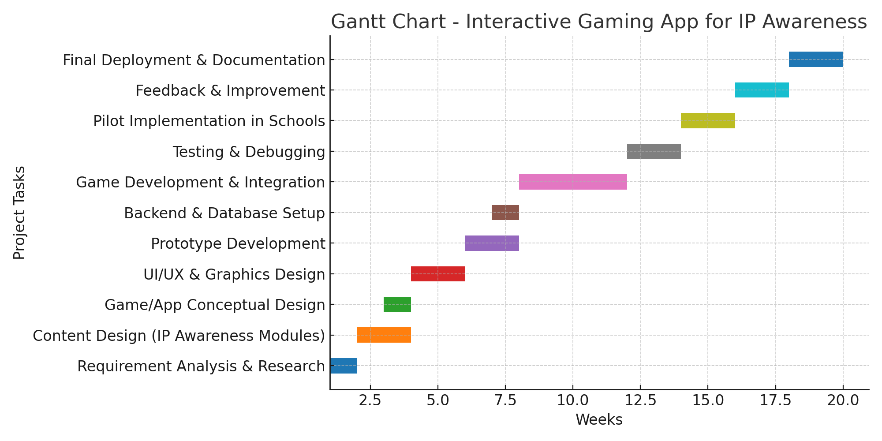
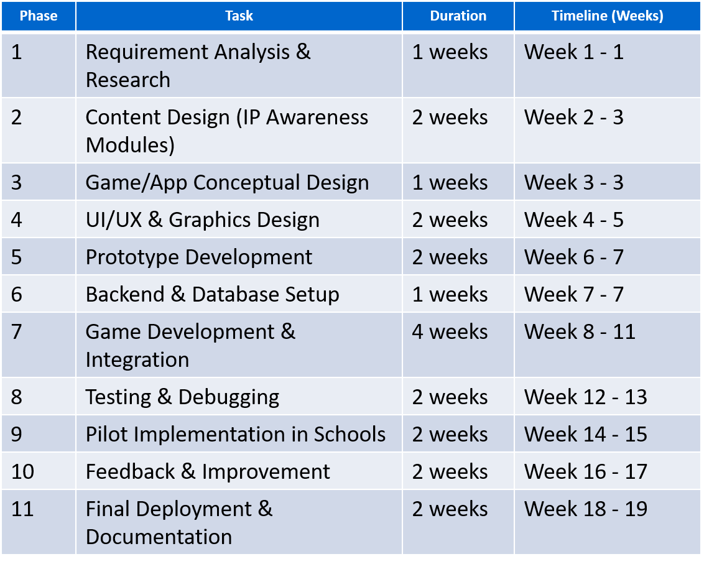
Timeline of the Project (Gantt Chart)

Slide 16
Github
https://github.com/darshan1612-nayak/Developing-an-Interactive-Gaming-Software-Mobile-Application-on-Intellectual-Property-IP-/tree/main

Slide 17
References
"Applied Case Studies for Children's Data Governance"
This IEEE report discusses ethical design principles for children's applications, emphasizing the importance of privacy, data governance, and inclusive design. While not specific to IP, the methodologies outlined can be applied to ensure your application is ethically sound and user-centric.
https://engagestandards.ieee.org/rs/211-FYL-955/images/IEEESA-Childrens-Data-Governance-Report.pdf
"The Benefits of a Multidisciplinary Lens for Artificial Intelligence Systems Education"
This paper highlights the importance of integrating ethical considerations into educational technologies. It underscores the need for a multidisciplinary approach, combining insights from ethics, design, and education, which is crucial when developing applications aimed at educating students about IP.
https://standards.ieee.org/wp-content/uploads/2023/07/ead-benefits-multidisciplinary-lens.pdf

Slide 18


